Slide 1

One Way Anova in SPSS
One-Way ANOVA Reveals Group Differences

Slide 2
What is Dependent and independent Variable in ANOVA Test?
Dependent Variable or criterion variable : The Factor or variable we are testing
Independent Variable : the outcome or the response variable
Examples:
1.An Economist would like to know if there are differences in income of Lecturers across the cities of London, Paris and Islamabad.
2.A Manager wishes to evaluate if staff satisfaction scores differ across permanent, part time and casual staff.
3.Is there a difference in optimism levels across three age levels?

Slide 3
What is ONE WAY ANOVA
"One-Way ANOVA compares the means of three or more groups to see if they are significantly different from each other. It helps us determine if there's a meaningful difference in at least one group, making it a valuable tool for statistical analysis."

Slide 4
What if there is significant difference?
We can conclude :
There exist some relationship between dependent and independent variable
It can be: positive, negative, linear, non linear, strong, weak, curvilinear, moderating, mediating.

Slide 5
Post Hoc Test
Tukey's HSD (Honestly Significant Difference) is an example of post hoc test.
It can help you identify which specific group(s) differ from each other when you have more than two groups.

Slide 6
How to run One Way ANOVA in SPSS?

Slide 7

Connecting to MyLab

Slide 8

Click On Connect to Apple/Windows Computer

Slide 9

Click On UNT General Access Virtual Desktop

Slide 10

Search For SPSS IBM Statistics

Slide 11
Problem
Consider a field study in which three fertilizers are tested and we want to compare their efficiency. Each fertilizer is used to grow ten plots and, then, the crops are harv ested.
yield_1 = 6.27, 5.36, 6.39, 4.85, 5.99, 7.14, 5.08, 4.07, 4.35, 4.95
yield_2 = 3.07, 3.29, 4.04, 4.19, 3.41, 3.75, 4.87, 3.94, 6.28, 3.15
yield_3 =4.04, 3.79, 4.56, 4.55, 4.53, 3.53, 3.71, 7.00, 4.61, 4.55

Slide 12
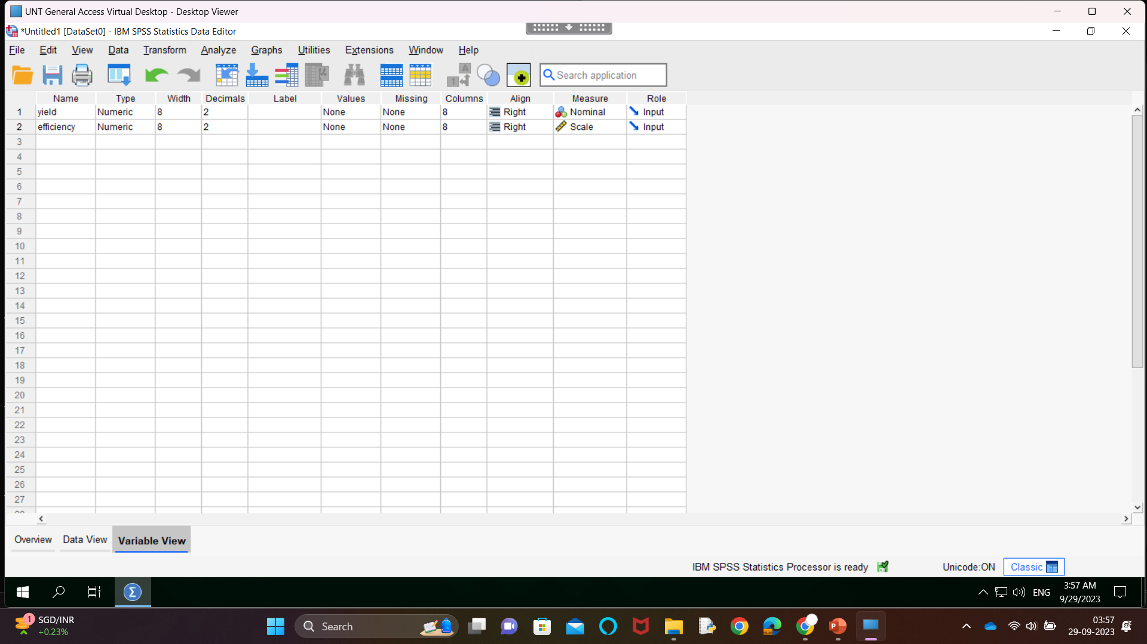
Define Variables

Slide 13
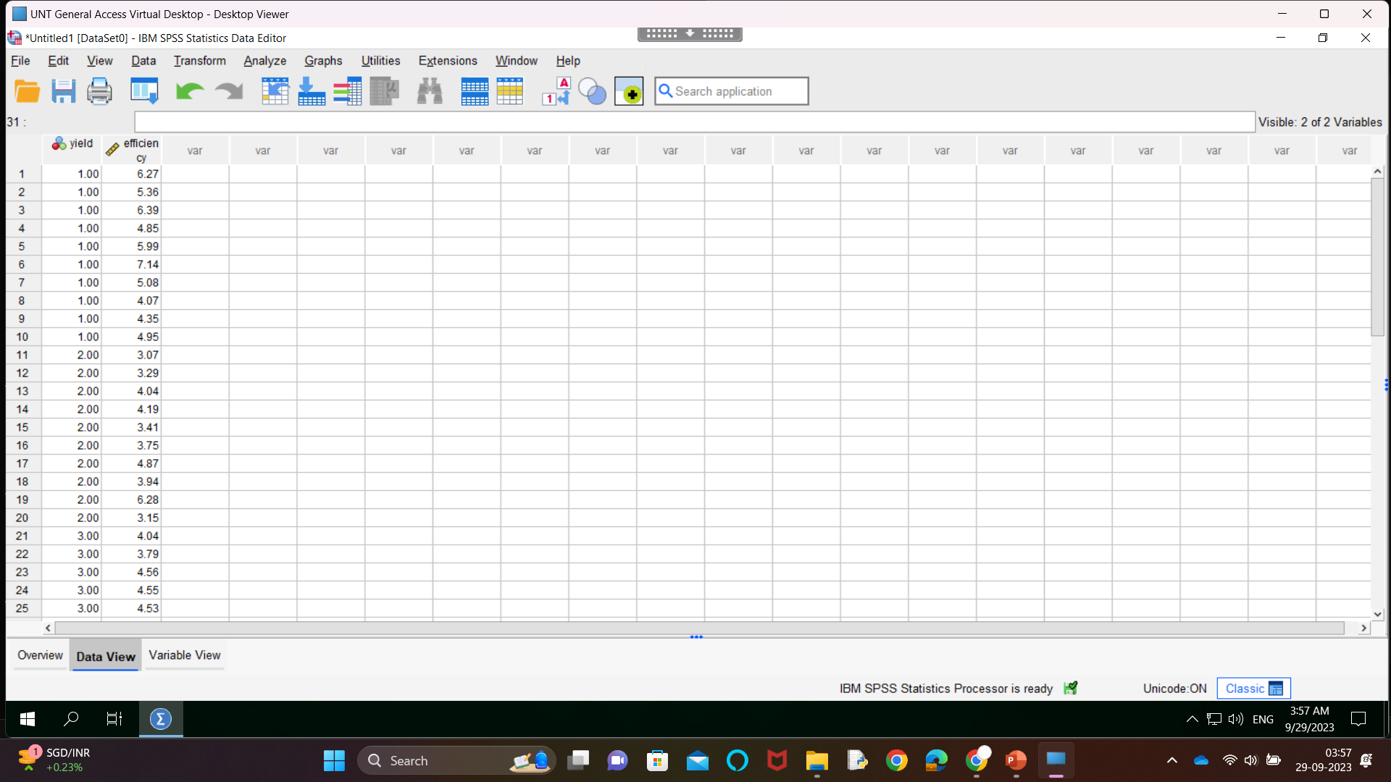
Define Dataset

Slide 14
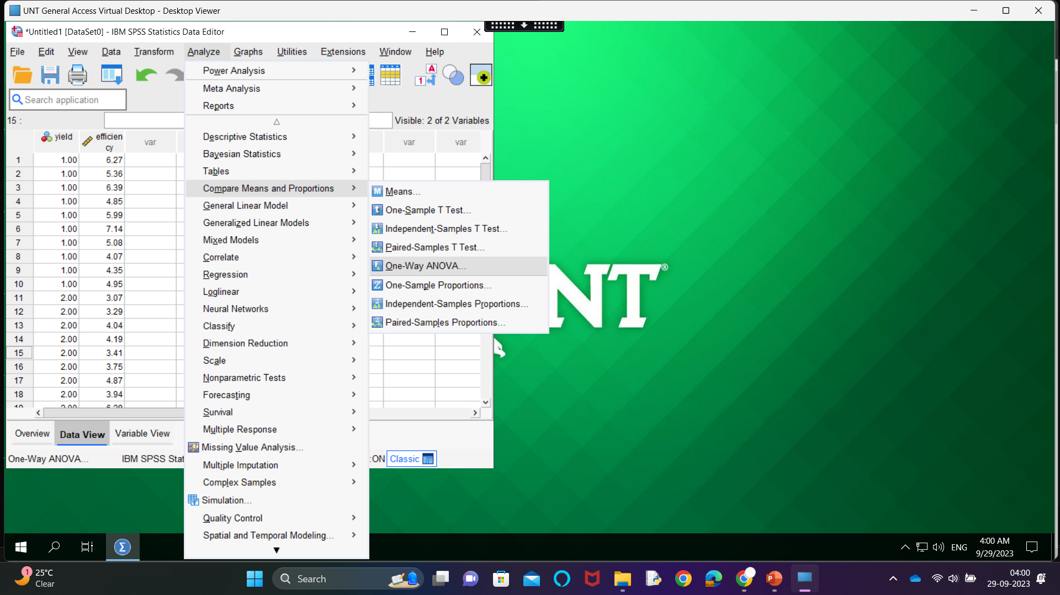
Next : Test ANOVA

Slide 15

Next

Slide 16
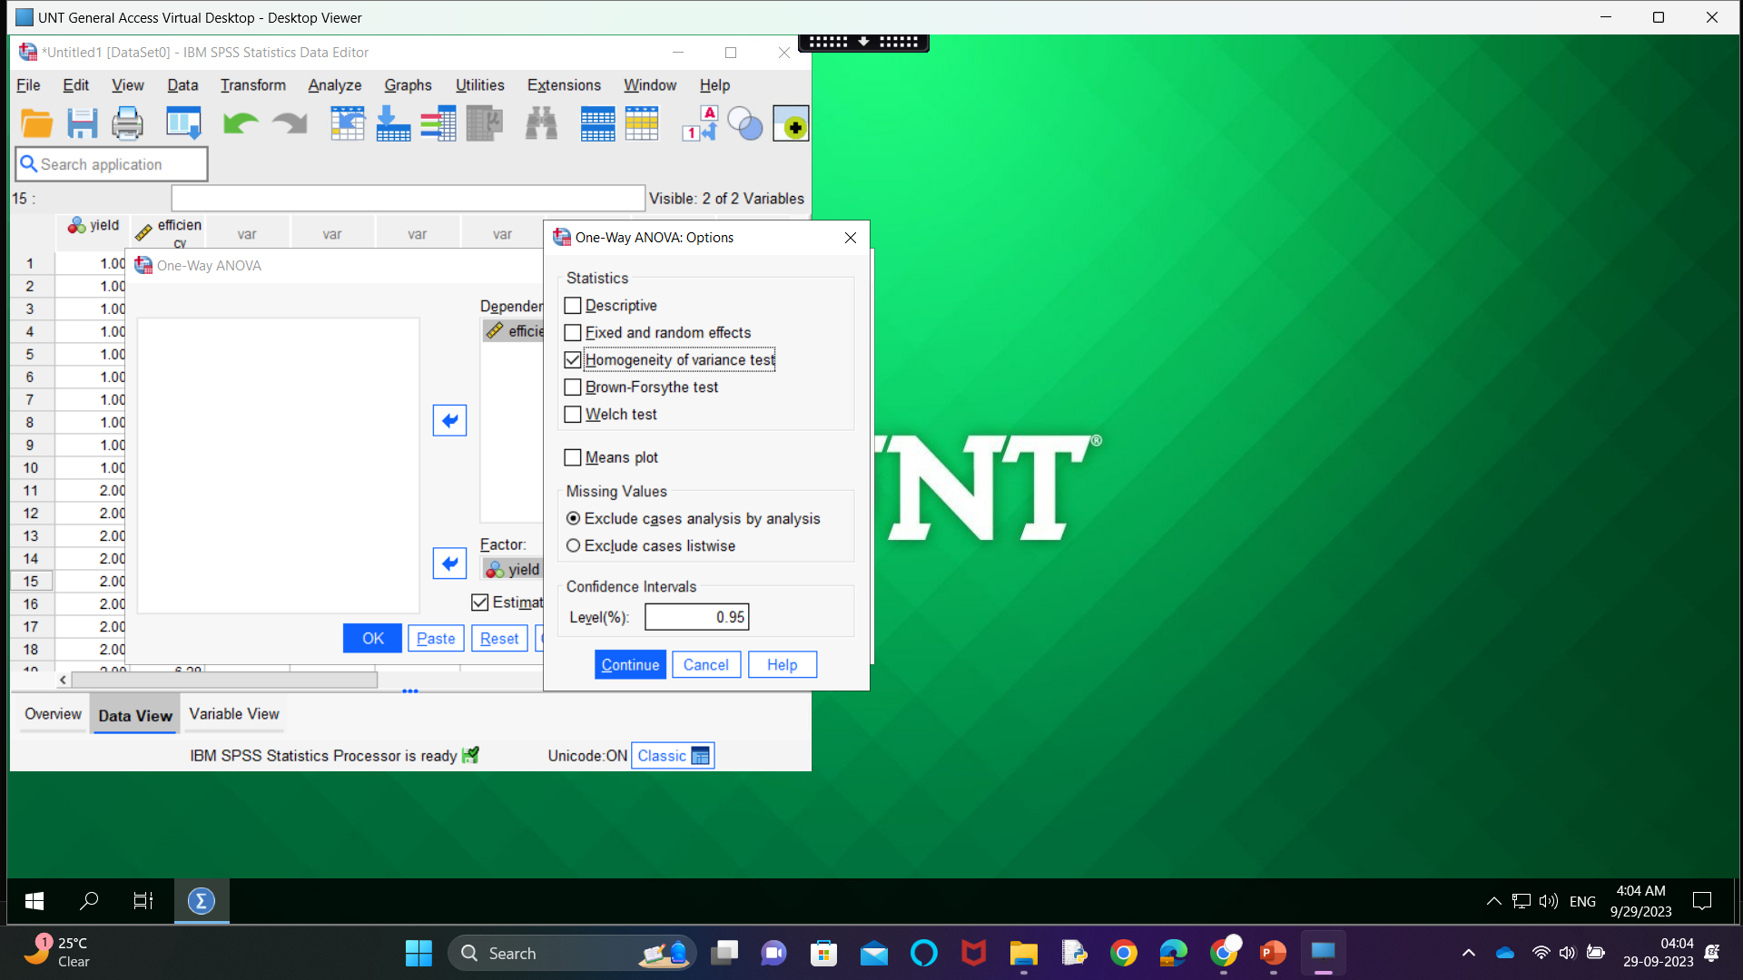
Next

Slide 17
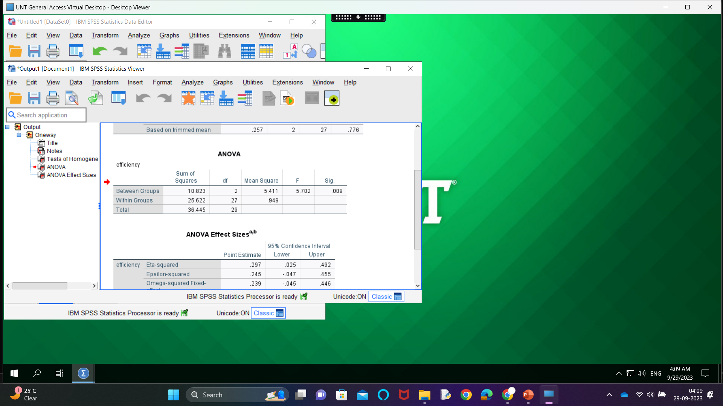
Output : Part 1 – Test ANOVA

Slide 18
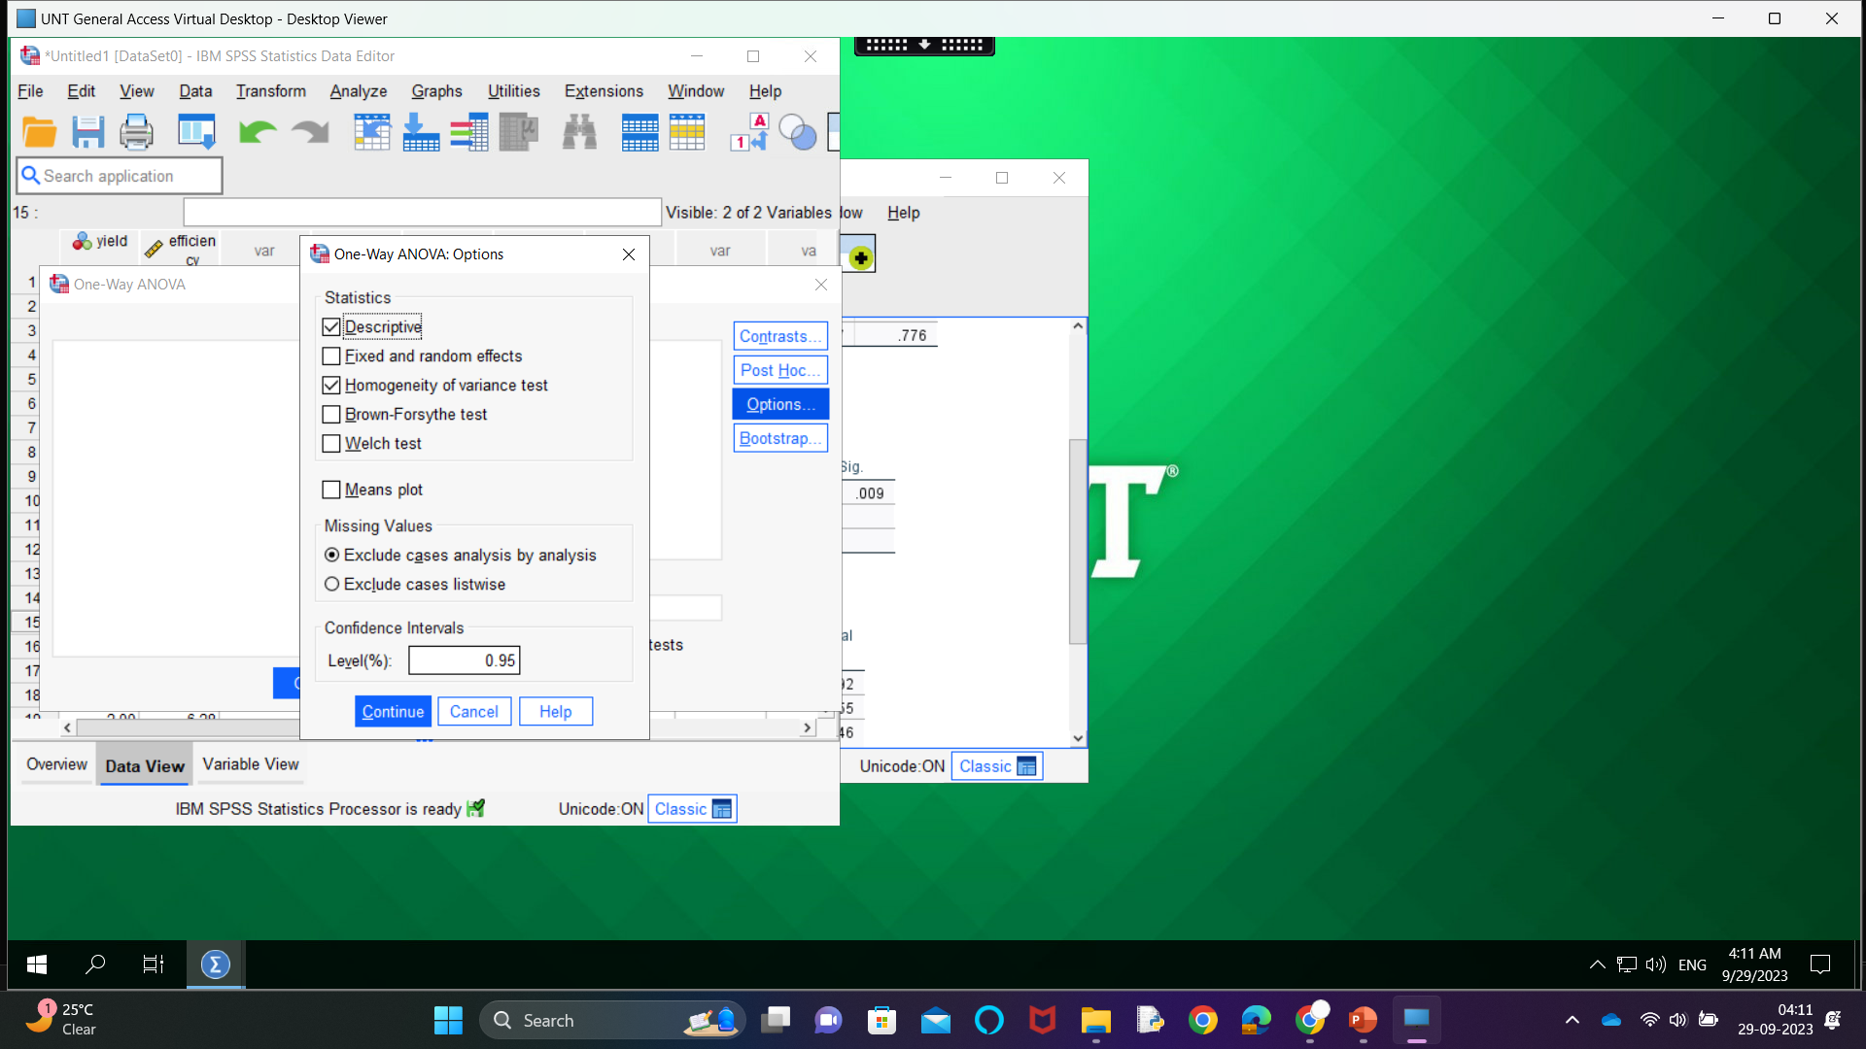
Next : Part 2 :Check Descriptive Statistics

Slide 19
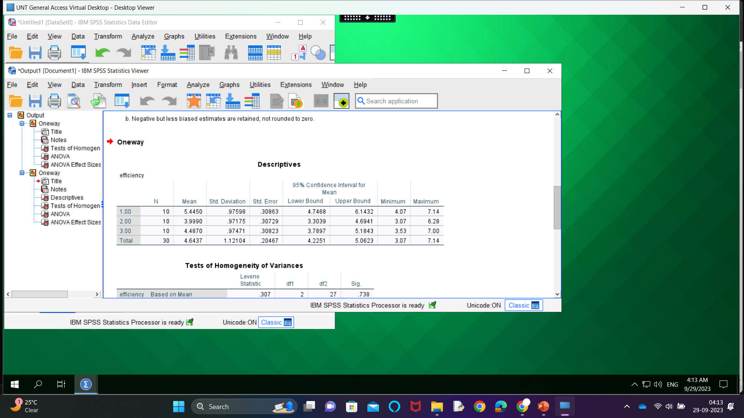
Output : Part 2-Descriptive Statistics

Slide 20
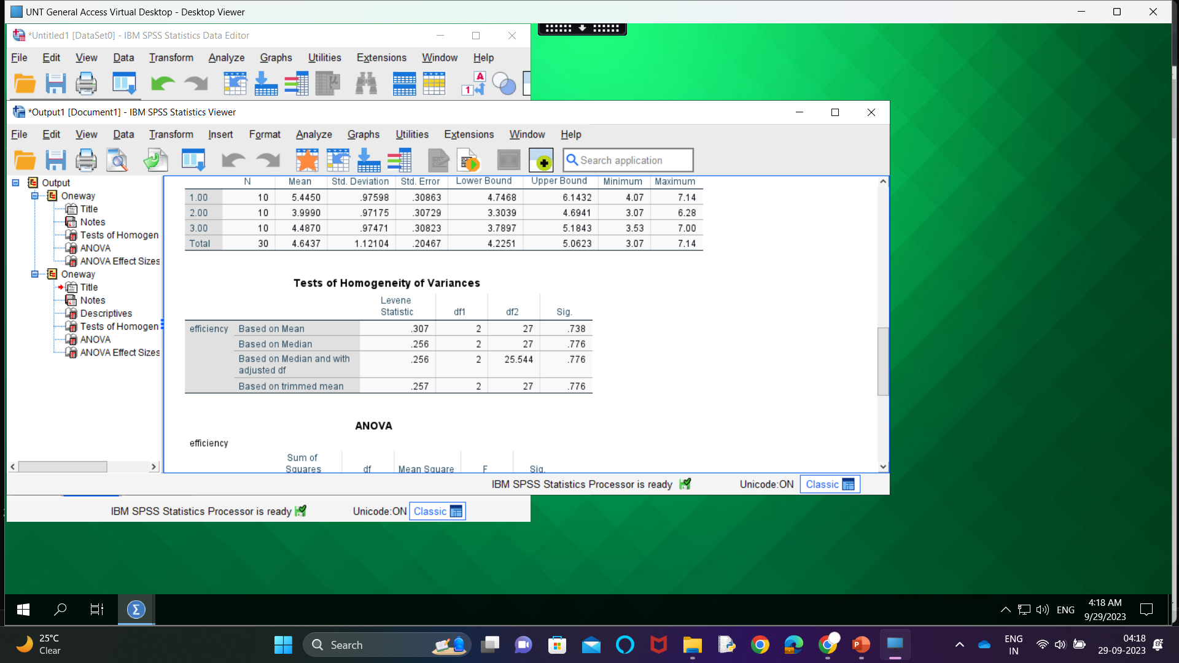
Next : Before Post Hoc Multiple Comparisions

Slide 21

Next : Post Hoc Multiple Comparision

Slide 22
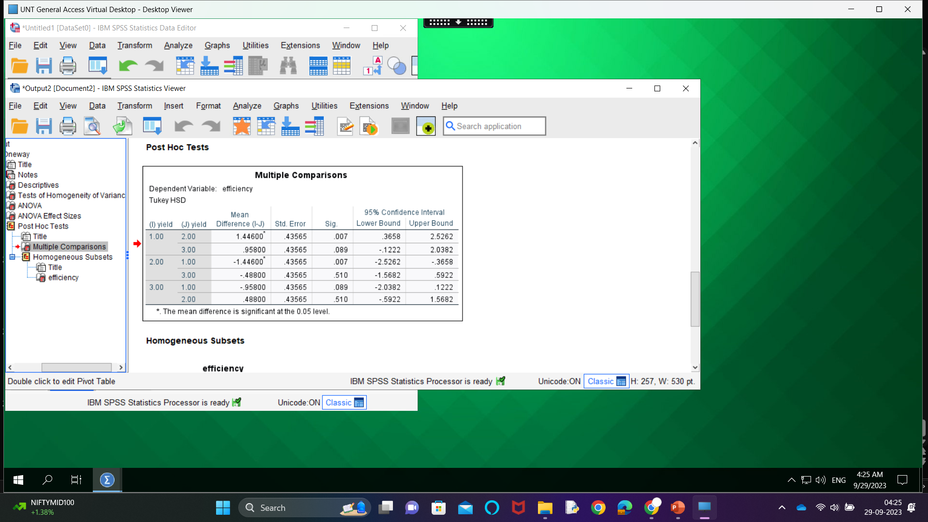
Next : output for post hoc Multiple Comparision

